Slide 1






Scottish PowerShell & DevOps User Group
22 July 2019
psdevopsug.scot | video.psdevopsug.scot
ScotPSUG | github.com/psdevopsug
meetup.com/Scottish-PowerShell-User-Group

Slide 2

Matt Muras (@vmse_mmuras)
Applying the HP / HPE PowerShell Scripting Toolkit
SPEAKERS

Slide 3


Incremental Group
THANK YOU!
Microsoft

Slide 4




SQL Server
Power BI
Data Analytics
Business Intelligence
Data Warehousing
PowerShell
Azure
@SqlGlasgow
Bit.ly/sqlglasgow
https://SQLGlasgow.co.uk

Slide 5


Glasgow Azure User Group
Founded in early 2017 as an independent body GAUG aims to bring the together the IT community to collaborate, network and learn from each other.
www.gaug.co.uk @GlasgowAzureUG

Slide 6
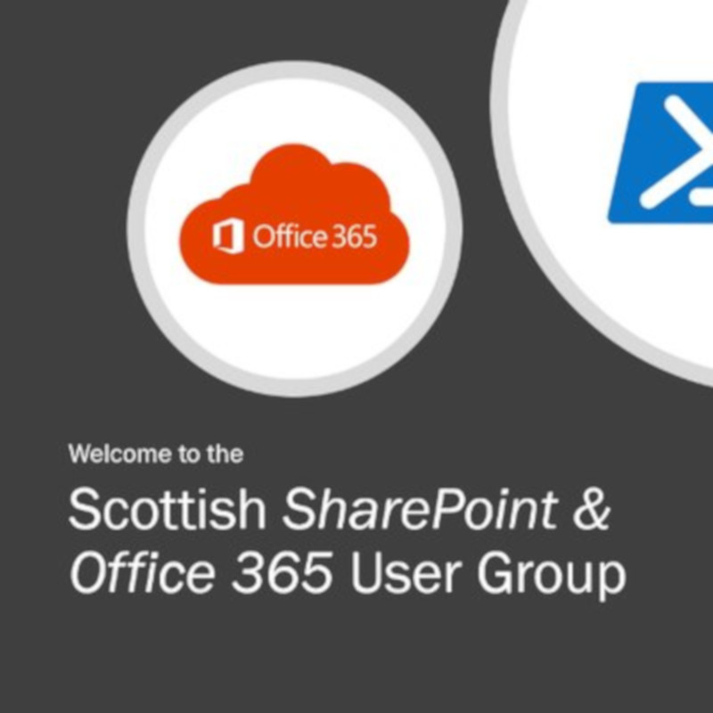
ScotSPO365UG
meetup.com/ScotSP0365UG

Slide 7




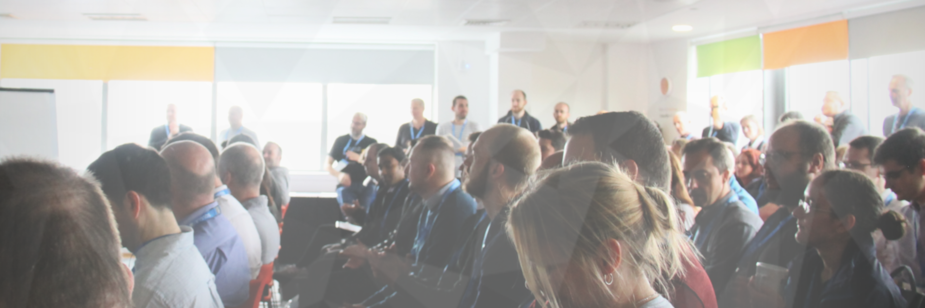



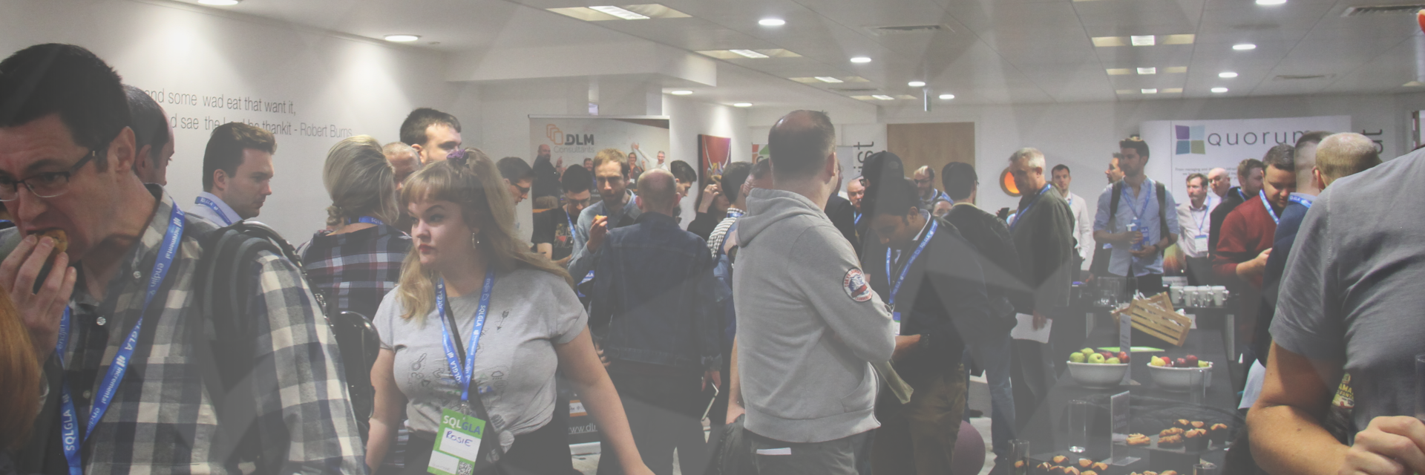
Scotland’s Data Platform Conference
Friday
13th Sept 2019
A full day of training sessions covering all aspects of the Data Platform
For news & updates first, Join our mailing list and follow us on Twitter
https://DATAScotland.org
@DATAScotland

